Slide 1
Understanding the Music
Intermediate Theory
Based on RSPBA Structured Learning – Book 2

Slide 2
Before we begin
It is highly recommended that you are high fluent in the concepts and knowledge from RSPBA Structured Learning Book 1
If you are going straight to the intermediate certificate make sure you review the PBQ presentation of the elementary certificate and try the PDQB practice exams to ensure you have this knowledge
Intermediate content builds further on concepts introduced in Book 1
Elementary material may be examined in the intermediate exam
Use the content in the slides along with Book 2.

Slide 3
Lesson 1 – Musical Instruments
Musical instruments are grouped into four main classes, depending on their construction and means of operations.
Stringed Instruments
The strings are set in motion by scraping, bowing, plucking or hammering.
Wind Instruments
The air inside the instrument is set in motion by blowing into or across a tube, either directly or through a reed.
Percussion Instruments
These are instruments which may be sounded according to their design e.g. Beaten, shaken, scraped or struck
Electrical Instruments
These date from about 1920. Electricity is the primary source of energy.

Slide 4
The mechanics of sound
There are four elements required to produce sound:
Originator - Piper / Drummer
(2) Vibrating Body - Reeds / Drumskins
(3) Medium - Air / Water
(4) Receptor - Ear
Should any one of these elements be missing, then sound cannot be produced.

Slide 5
STOP AND THINK
What is a musical instrument?
List the 4 main classifications into which musical instruments are grouped and describe how they create sound.
With each of the above, how would you change the pitch?
Answers: 1. a device which can produce vibrations in the air. These vibrations are converted by the human brain into musical sound. 2. Stringed (scaping, bowing, plucking or hammering the strings), wind (air blown across a tube or reed), percussion (beaten, shaken, scraped or struck), electric (electricity). 3. shorten/lengthen strings, shorten/lengthen column of air or faster/slower air, hit harder, increase electricity frequency.

Slide 6
Lesson 2-5 – How do instruments work
For this section have a read and get a general understanding of how each instrument works
This section should form a lesser focus compared to other sections

Slide 7
Lesson 6+7 – Time Signatures
Revise time signature info from Book 1
Time is the means by which music is measured into units called beats (or pulses) which are grouped into bars
Time must not be confused with tempo
Simple Quadruple Time (4/4) is often known as Common Time and represented by a in place of the time signature
Simple Duple Time (2/2) is called ‘Cut Common’ or ‘Alla Breve’ time, and shown as
Remember, to convert from simple to compound time we multiply the upper number by 3

Slide 8
STOP AND THINK
What information is given in a time signature?
Give the time signature for alla breve time
When ‘C’ is given as a time signature, what is understood?
What is a simple beatnote and compound beatnote?
What are the three kinds of time?
Answers: 1. how many beats per bar (top) and the value of those beats (bottom). 2. 2/2. 3. It is 4/4 time. 4/ Simple divisible by 2, compound divisible by 3. 4. Duple, Triple, Quadruple

Slide 9
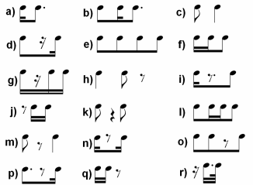
Lesson 7 – Worksheet
For each of the below state if it is simple or compound

Slide 10
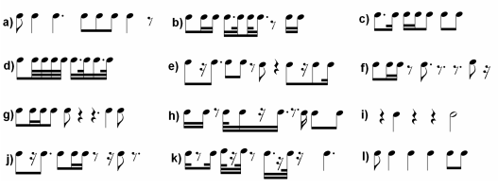
Lesson 7 – Worksheet
Give the time signature for each of the following bars:

Slide 11
Lesson 8 – Irregular Groupings
An irregular group is the division of a beatnote (or portion of a beatnote) into a greater or lesser number of parts than normal
An irregular group is indicated by a number positioned above or below the affected notes, contained by a curved line
Typically for simple time this will be a 3 or 6. For compound time a 2 or 4. For both simple and compound it may be 5 or 7.
An irregular grouping may sit within the regular grouping
Exercise: illustrate a bar each of 4/4 and 6/8 incorporating irregular groups

Slide 12
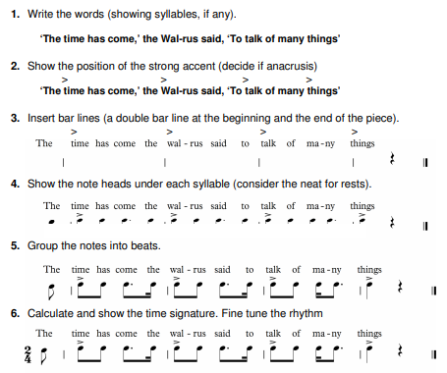
Lesson 9 – Music and Speech
Music and speech both use rhythm
Nursery rhymes introduced us to rhythmical language
We need an anacrusis if the note comes before the first strong accent

Slide 13
Lesson 10 – Asymmetric Time
Occurs when the number of beats or pulses per bar is five or seven, and are obtained by combining different kinds of time.
The subsequent strong accent (S) would become a medium accent (M)
Quintuple Time (5)
Duple + Triple (2 + 3 = 5)
S W + S W W becomes S W M W W
Triple + Duple (3 + 2 = 5)
S W W + S W becomes S W W M W
Septuple Time (7)
Triple + Quadruple (3 + 5 = 7)
S W W S W M W becomes S W W M W M W
Quadruple + Triple (5 + 3 = 7)
S W M W S W W becomes S W M W M W W
Just like regular timings, to take asymmetric time from simple to compound we multiply the top number by 3 and the bottom number by 2
5/4 (Simple Quintuple) becomes 15/8 (Compound Quintuple)
7/4 (Simple Septuple) becomes 21/8 (Compound Septuple)

Slide 14
STOP AND THINK
If a bar of music contains five or seven beats or pulses, what term would you use to describe the ‘time’?
Which kinds of time form the sub-groups in (a) quintuple time, (b) septuple time?
Give an example of the beat accent of septuple time
What is the corresponding compound time for 7/4?
Write down 4 bars of asymmetric music, each bar a different time, and indicate the natural accents of each (s, m and w)
Answers: 1. asymmetric time 2. (a) duple, triple (b) triple, quadruple 3. S W M W M W W or S W W M W M W 4. 21/8

Slide 15
Lesson 11 – Corresponding Time
To convert simple time to compound time we follow these steps:
Simple beat notes become dotted notes.
Regular groups will become irregular groups.
Irregular groups will become regular groups.
All unequal irregular groups e.g. quintuplets and septuplets remain irregular.
The anacrusis and the last note in the incomplete bar must be altered to the correct value.

Slide 16
Lesson 11 – Corresponding Time
To convert compound time to simple time we follow these steps:
Compound beat notes become dotted notes.
Regular groups will become irregular groups.
Irregular groups will become regular groups.
All unequal irregular groups e.g. quintuplets and septuplets remain irregular.
The anacrusis and the last note in the incomplete bar must be altered to the correct value.

Slide 17
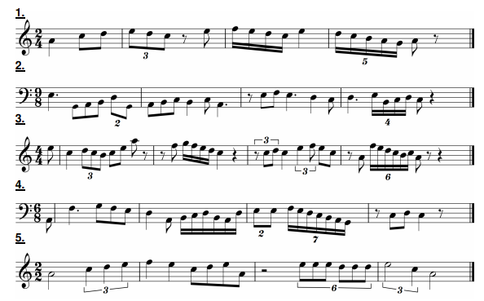
Lesson 11 – Worksheet
Convert the below to their corresponding times

Slide 18
Lesson 12 – Accents and Rhythm
Notice how you can march or clap when listening to music? This is called the pulse, beat, or accent
Not all accents are equal – we have strong, medium and weak, called natural accents because they occur in natural patterns
It is the regular strong accent which creates rhythm
Sometimes we emphasise a beat beyond its natural strength (pull out a particular note). This is called dynamic accent
Drummers do this by varying volume
Bagpipers use agogic stress (lingering on the note beyond its exact value), as well as embellishments

Slide 19
Lesson 12 – Syncopation
Syncopation is a used to disturb the natural rhythmic flow – creating excitement and colour in the music. Four common methods include:
1. Stressing a weak accent
2. Putting rests in place of strong accents
3. Tying a weak accent over a strong accent
4. Changing the natural pattern by introducing a change of time signature
Here’s an example of bagpiping syncopation:

Slide 20
STOP AND THINK
What is meant by the terms (a) Natural accents (b) agogic stress
Explain what is meant by a dynamic accent and how it is achieved
State which method(s) have been used to achieve syncopation below:
A
Answers: 1. (a) accents occurring in the natural pattern (Strong, Medium, Weak (b) holding a note beyond its exact value. 2. Emphasising a beat beyond its natural strength by varying volume or using agogic stress 3. (a) putting rests in place of strong accents (b) tying a weak accent over a strong accent + stressing a weak accent (through embellishments)

Slide 21
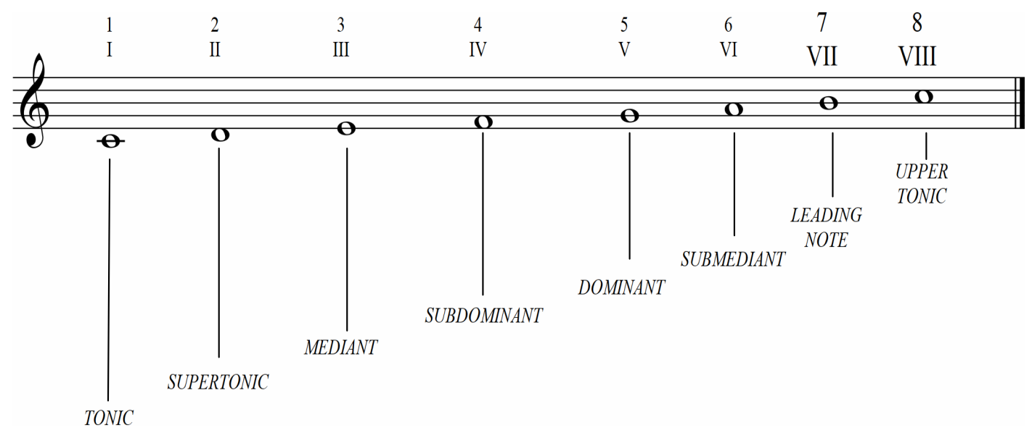
Lesson 13 – Degrees of the Scale
Memorise me!
The degrees of the scale (pitch) are represented by the letters A-G
We can also describe their position based on numbers (1-8) or order of importance, in relation to the tonic (the first note of a scale)

Slide 22
Lesson 13 – Degrees of the Scale
The first is termed the TONIC or KEYNOTE
The second, the SUPERTONIC, is the degree immediately above the TONIC
The third, the MEDIANT, is mid-way between the TONIC and DOMINANT
The fourth, the SUB-DOMINANT, is the degree immediately below the DOMINANT
The fifth is the DOMINANT and has an important (dominant) role in the scale
The sixth, the SUB-MEDIANT, is mid-way between the SUB-DOMINANT and the OCTAVE.
The seventh, is the LEADING NOTE because it leads to the OCTAVE
The eighth is the OCTAVE or UPPER TONIC – also the first of a new scale

Slide 23
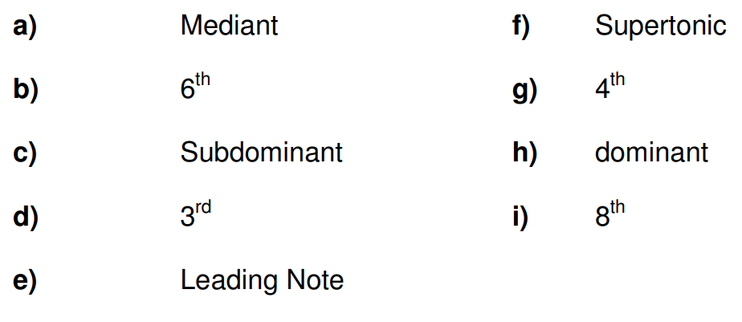
STOP AND THINK
What is a scale?
What three ways can we use to describe the degrees of the scale?
On the chanter scale from A to A, give the pitch names of the following degrees
Answers: 1. a set of musical notes ordered by pitch 2. Letters A-G, numbers, order of importance 3.C, F, D, C, High G, B, D, E, High A

Slide 24
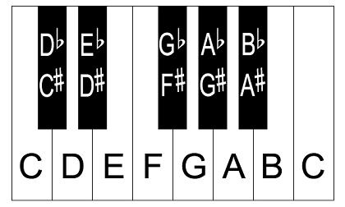
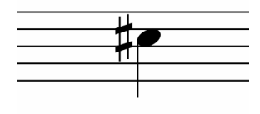
Lesson 14 – Accidentals
The smallest movement on a piano (including white and black notes) is called a semitone. Two semitones equal a tone.
The pitch of a note may be raised or lowered by an interval of a semitone or tone, using an accidental symbol
Sharp – raises the pitch by one semitone
Flat – lowers the pitch by one semitone
Double Sharp – raises the pitch by one tone (two semitones)
Double Flat – lowers the pitch by one tone (two semitones)
Natural – cancels any existing accidentals, restoring the note to its original pitch
or
When we raise the pitch we can say it is augmented.
When we lower the pitch we can say it is diminished.

Slide 25
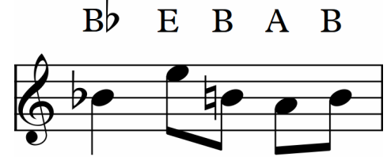
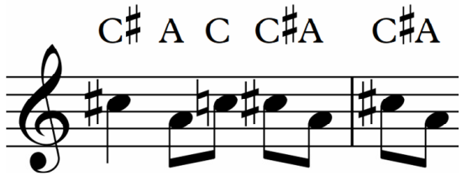
Lesson 14 – Accidentals
When a note is affected by an accidental it remains at that pitch for the remainder of the bar, unless contradicted by the natural sign.
Here we use a sharp (♯) on the first C and it applies for the rest of the bar
Here we have a B flat (♭) followed by a B with a ♮ used to make a regular B. The third B therefore maintains the ♮ to be a regular B
Here we have a C♯ followed by a C♮ and then a C♯ again, each requiring an accidental. The start of the next bar then requires another accidental to augment the C to be a C♯

Slide 26
STOP AND THINK
What is a semitone?
What does an accidental indicate?
Show and name the accidentals that are in normal use, explaining their affect to the pitch of a note
What is meant by (a) augmented, (b) diminished
If an affected note recurs throughout a melody, what must be done to maintain its pitch?
Answers: 1. the smallest movement on a piano 2. how to raise or lower the pitch of a note 3. ♯ - sharp – raise 1 semitone, ♭ - flat, lower 1 semitone, ♯♯ - double flat – raise 1 tone, ♭♭ - double flat – lower 1 tone, ♮ - natural – restore to original pitch 4. augmented = sharpened/raised, diminished = flattened/lowered 5. use the accidental on the first affected note of each bar (or use it in the key signature)

Slide 27
Lesson 15 – enharmonic notes
When two notes have different names but are the same pitch, they are called enharmonic
Notice in the diagram above that each of the black keys has both a ♯ and ♭ note? These are enharmonic
Notice how there is no black key between E and F? This means E♯ is actually the note F, and F♭ is actually E – making E♯ and F enharmonic, and E and F♭. The same goes with B and C.
Enharmonics also apply with double sharp and double flat. E♭♭ (flattened/deminished by a tone) becomes D. So E♭♭ is enharmonic with D

Slide 28
STOP AND THINK
Explain the term ‘enharmonic’
If a note is played on the piano and referred to as E♭, what other name could enharmonically describe the same pitch of note
What word would you use to describe jointly the two notes B♯ and C?
Name the note or notes that are enharmonically equivalent to:
(a) G♯ (b) C (c) B♭ (d) D♭♭ (e) D♯♯
Answers: 1. notes of the same pitch with different names 2. D♯ 3. Enharmonic 4. A♭, B♯, A♯, C, E

Slide 29
Lesson 16 – transposition
Don’t confuse transposing with transcribing! Where music has been written for another instrument and you want to write it out on the bagpipes this is transcribing the music to bagpipes.
Transposing = one key to another
Transcribing = one instrument to another
Transposition means the changing of a
melody by raising or lowering its pitch
Are there some songs where you can’t sing the really high or low notes? By transposing we move the melody into an area that we are more comfortable
For now we are going to transpose from one clef to another
To transpose an A from treble to bass clef we simply find the A on the bass clef. Notes after that will then be the same notes but on the new clef.

Slide 30
Lesson 16 – Worksheet
See answers page for a shortcut!

Slide 31
Lesson 16 – Answers
Shortcut:
- Down 1 clef = note moves down by 1 degree (1 step down the scale)
- Down 2 clefs = note moves down by 2 degrees
- Up 1 clef = note moves up by 1 degree
- Up 2 clefs = note moves up by 2 degrees

Slide 32
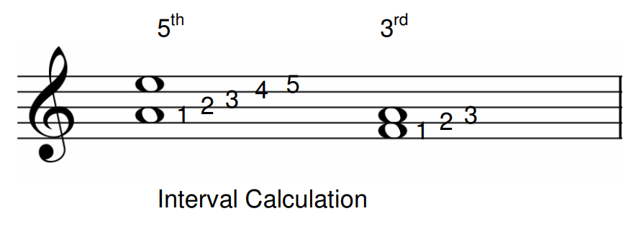
Lesson 17 – intervals
An interval is the difference in pitches between two notes
The interval is calculated by counting the number of degrees or steps between the two notes (with the first note counted as one step)

Slide 33
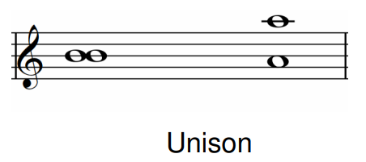
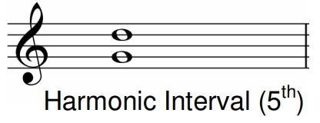
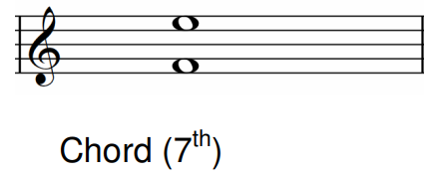
Lesson 17 – intervals
Examples
Unison is the sound of two or more notes of the same pitch, or an octave apart. In drumming ‘unison’ is also where all the snare drummers play together to highlight specific aspects of the rhythm
A melodic internal occurs when two notes which are at least one interval apart are played in succession
A harmonic interval occurs when two notes which are at least one interval apart are played simultaneously (a.k.a a ‘chord’). A chord may be pleasant (concordant) or unpleasant (discordant).
A simple interval describes any interval within an octave
A compound interval describes any interval greater than an octave

Slide 34
STOP AND THINK
What is an interval?
What is a harmonic interval?
What is a melodic interval?
What is unison?
Explain the terms concordant and discordant
What is a simple and compound interval?
Answers: 1. the difference in pitches between two notes 2. two notes atleast an interval apart are played simultaneously 3. two notes atleast an interval apart are played in succsssion 4. two or more notes the same pitch or an octave apart 5. pleasant and unpleasant chords 6. simple is within an octave, compound is more than an octave

Slide 35
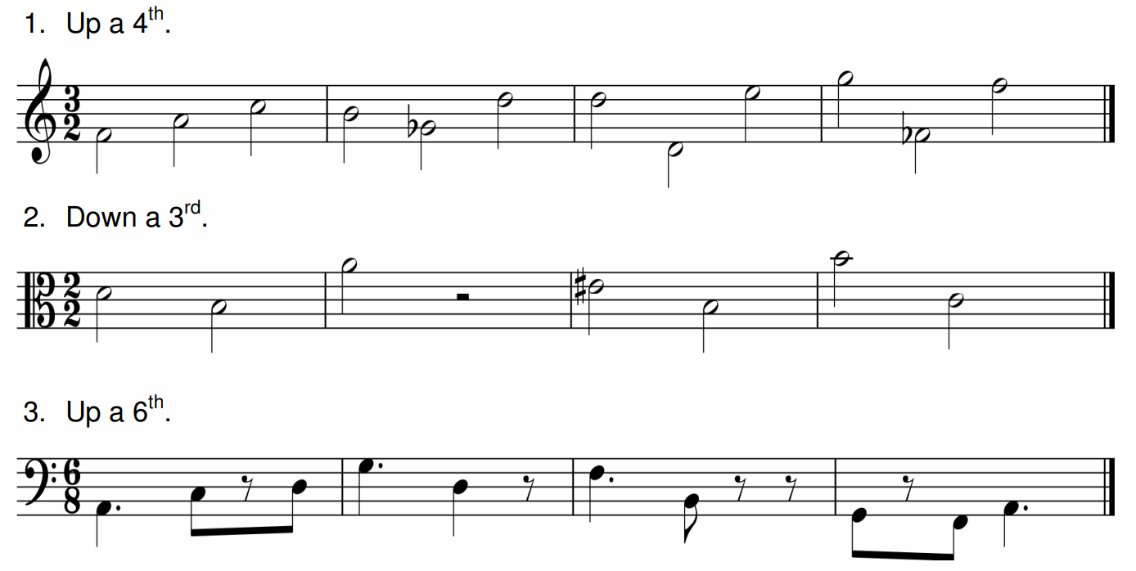
Lesson 17 – Worksheet
Steps:
Move the notes the desired number of intervals – ignoring any accidentals
Reapply the accidentals
Transpose the following:

Slide 36
Lesson 17 – Answers

Slide 37
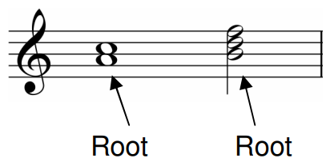
Lesson 18 – Harmony
Harmony is the combination of two or more musical sounds of different pitch
When two or more notes are sounded simultaneously they form a ‘chord’. The fundamental (bottom) note of that chord is called the ‘root’
The most common form, called a triad, has three notes – a root, a third interval (3rd) and a fifth interval (5th)
We can change the position of the notes of the chord by inversion
Inversion can occur upward or downward by an octave

Slide 38
Lesson 18 – Harmony
When the root of a triad is inverted (raised by an octave) this is its first inversion
When the 3rd of a trial is inverted this is its second inversion

Slide 39
Lesson 18 – Harmony
A two note chord with an sixth interval will be known as a sixth
However when we invert the root of the chord there now only exists a third interval between the two notes, so we call it an inverted third
This can occur with any two note chords, and the original interval (6th) and new interval (3rd) will always add to 9

Slide 40
Lesson 18 – Types of harmony
Sometimes to create a chord we will play each note in rapid succession (rather than at the same time). When the sounds are sustained (the pedal on a piano) the chord is called arpeggio
The harmony provided by the bagpipe drones is called pedal harmony
Sometimes in bagpipe music we will refer to harmony as ‘seconds’ or ‘thirds’. This should not be confused with intervals

Slide 41
STOP AND THINK
What is harmony?
What is a chord?
What is a triad?
What is the name given to the fundamental note of a chord?
What is meant by inversion?
Describe the term Arpeggio
Answers: 1. the combination of two or more musical sounds of different pitch 2. two or more notes sounded simultaneously 3. A chord containing a root, 3rd and 5th 4. Root 5. changing the position of a note in a chord up or down an octave 6. sounding notes in rapid succession which when sustained form a chord.

Slide 42
Lesson 18 – Worksheet
Name the inversions of the following intervals:
5th (b) 2nd (c) 1st (d) 7th (e) 4th (f) 6th
State whether the following intervals are simple or compound, and give their numerical value
Answers: 1. 4th, 7th, 8th, 2nd, 5th, 3rd (they add up to 9 remember!) 2. (a) simple 8th/octave (b) simple 6th (c) simple 3rd (d) compound 2nd (or 9th) (e) simple 7th (f) compound 2nd (g) simple 5th (h) simple 5th

Slide 43
Lesson 18 – Worksheet
Show the triad in its three positions and name them
Invert the following Intervals and name them:

Slide 44
Lesson 18 – Answers
Show the triad in its three positions and name them
Invert the following Intervals and name them:
5th 3rd 6th 3rd

Slide 45
What else do I need to study?
Get familiar with the RSPBA Structured Learning – Book 2
Practice the technique exercises in Book 2 (P65 – 97 depending on instrument)
Read P104 onwards on instrument tuning and understand how to tune your bagpipes/drum including how to troubleshoot issues and adjust reeds
Practice your music writing – a 4 parted MSR is required
Be confident at sight reading an MSR (try working through the Scots Guards books and sight read some tunes)
Playing requirements – 4 parted MSR + Ground and 1st variation of a piobaireachd
Find practice exam papers (level 6-8) at the Piping and Drumming Qualification Board (PDQB)
Exam enrolment form - https://www.pipebandsaustralia.com.au/college

