Slide 1
Understanding the Music
Preliminary and Elementary Theory
Based on RSPBA Structured Learning – Book 1

Slide 2
Notes
Notes are used to indicate what we are playing – it provides the tune, just like letters add up to words and sentences for a story.
Notes provides us with 2 pieces of information:
  Pitch: Which note are we playing? How high or low?
  Duration: How long are we playing that note for?
The pitch of the notes use the letters A – G (with some repeated on the bagpipes).

Slide 3
The Staff (plural: stave)
The word staff means the lines that we write our music on.
We add a clef to the staff to show us where on the great staff we are.
The notes below are written on the “Great Staff”.
By writing our notes on a staff, we use staff notation.

Slide 4
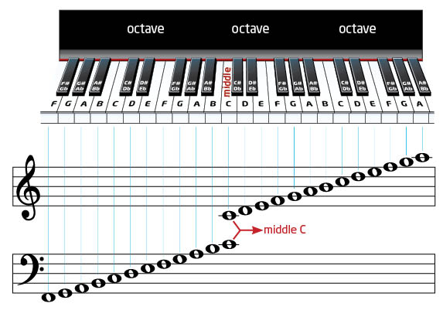
The Staff on a piano
For the notes we simply work our way up along the white keys.
The very middle note on a piano we call middle C.
You will notice there are 3 of each note - each of a different pitch. These are exactly 8 notes apart – an octave.
The first note in the scale is called the tonic. Each step up the scale can be referred to as a degree, with the distance between each referred to as an interval.

Slide 5
How does this apply to bagpipes and drums?
The combination of the same note at different pitches with different instruments creates our harmonic.
In the case of bagpipes and drums, all instruments and notes are tuned in reference to low A of the chanter.
This is possible due to each A being a full octave apart.

Slide 6
How do we write our music?
Bagpipes can only play on the treble clef, so we use a short staff (just the 5 lines of the treble clef)

Slide 7
How do we write our music?
Drummers used to write their music on a short staff, but now use a single line – as the snare drum has indefinite pitch (doesn’t sound a note)
This is called mono-linear notation
Above the line means right hand, below the line left hand.
Bass, tenor and snare all write their music on the bass clef.

Slide 8
But tenor drummers play notes right?
While tenor music is written in mono-linear notation, they do in fact play a pitch which is tuned to notes, creating a harmonic with that note on the bagpipe chanter.
Tenor drums come in all different sizes and so tune their drums to a note on the bass clef.

Slide 9
All together now!
While we don’t often write all instruments together, when we do this is called a full score – with the bracket joining it called a brace.

Slide 10
STOP AND THINK
What is the main purpose of notation in music?
Name the system of notation which is used in modern music.
How many notes are in an octave?
How many (and which notes) can we play a full octave difference on the bagpipes?
Why are clefs important?
Which clef signs are used to indicate the pitch range of the (a) bagpipe, (b) bass and tenor drums
What is a degree and an interval?
Answers: 1. To notate pitch and duration, 2. Staff Notation, 3. 8 notes in an octave 4. G and A (hence the use of ‘low’ and ‘high’), 4. To tell us which note we are referring to when there are multiple of the same note. 5. (a) Treble/G Clef, (b) Bass/F clef 6. Each step up the scale can be referred to as a degree, with the distance between each referred to as an interval.

Slide 11
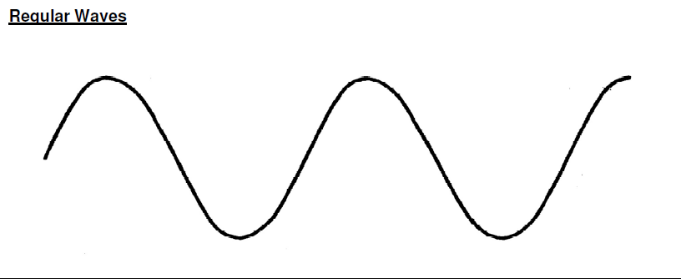
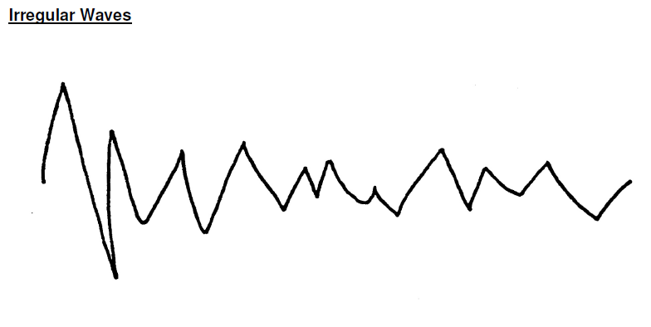
That doesn’t sound like music!
Sound that we hear creates a noise, but sometimes this is musical and sometimes unmusical sound.
They can be distinguished by regular sound waves (musical) and irregular sound waves (unmusical)

Slide 12
That doesn’t sound like music!
Musical sound will constantly produce musical sound
Unmusical sound (noise) will rarely reproduce the same sound and wave pattern
QUESTION TIME!
Can you think of examples of musical and unmusical sounds?
What are the two main categories into which sound can be divided?
Show the wave pattern which you would expect from a sound produced by (a) a musical instrument, (b) a non-musical instrument

Slide 13
Note duration
Duration is the length that we hold a note.
Each note duration is represented with a different symbol, much like each letter of the alphabet is different.
What do I have to know about these?
  Their name
  Their value
  How many beats does it have?

Slide 14


The Semi-breve and Minim
How many minims in a semi-breve?
The semi-breve is our largest note. We call it a whole note. Think of a whole cake, containing 4 quarters. This will make 4 beats.
The minim is worth half of a semi-breve, so we only have half a cake. This gives us 2 quarters, or 2 beats.

Slide 15

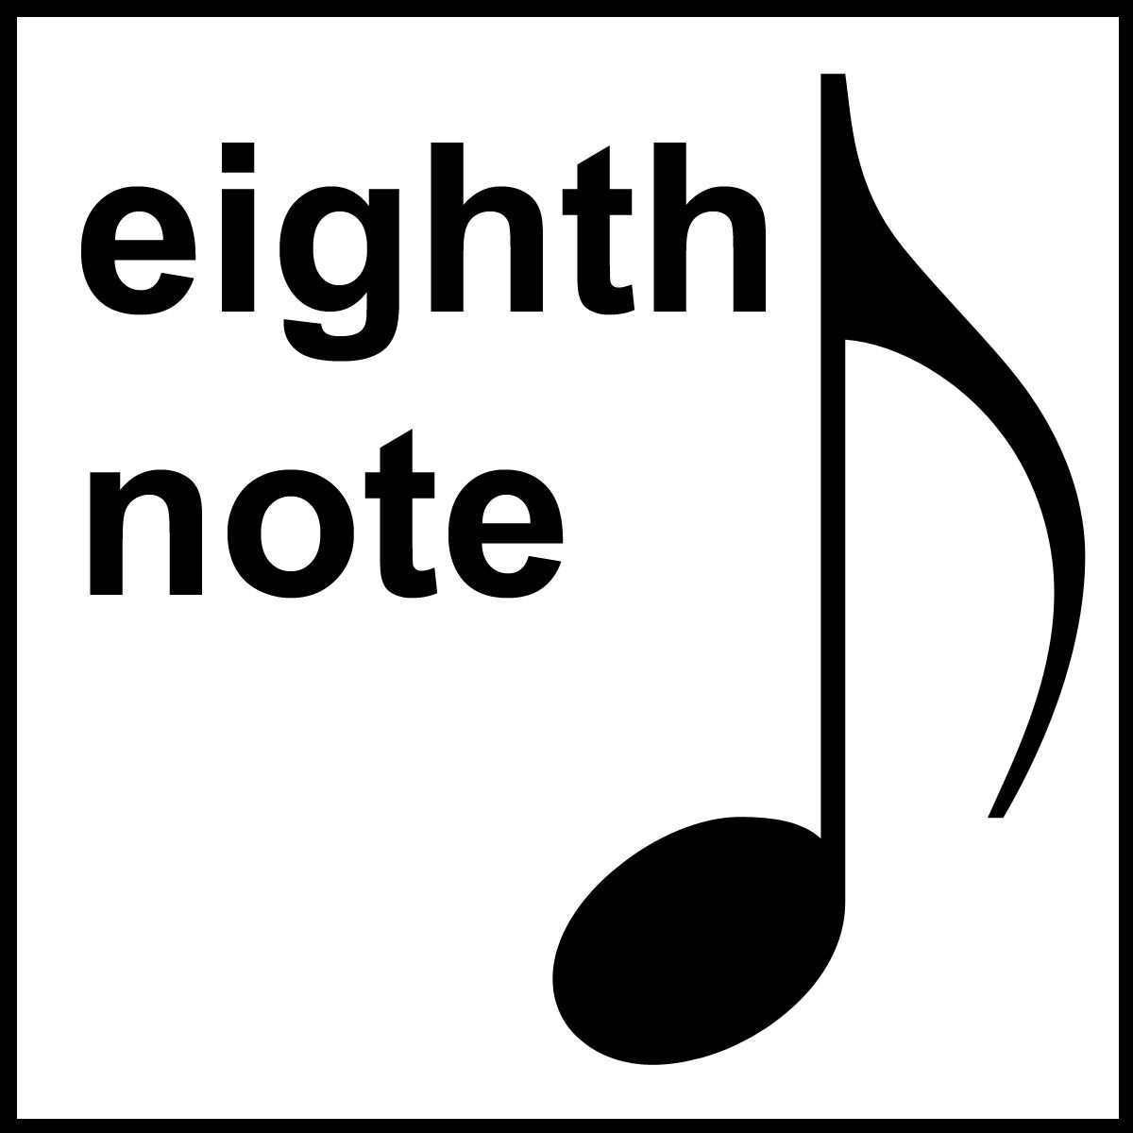
The Crotchet and Quaver
How many crotchets in a semi-breve?
The crotchet is worth half of a minim, so now we only have a quarter of a cake. This give us only 1 quarter, or 1 beat.
The quaver is worth half of a crotchet, so we only have an eighth of a cake. Because a crotchet was 1 beat, a quaver is half of a crotchet beat.

Slide 16
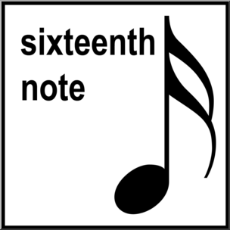

The Semi-Quaver and Demi-Semi-Quaver
The semi-quaver is worth half of a quaver, so now we only have a sixteenth piece of cake. This give us a tiny piece of the quarter, or a quarter of a crotchet beat.
The demi-semi-quaver is worth half of a semi-quaver, so we only have a thirty-second piece of cake. This gives us an eighth of a crotchet beat.
Thirty
second
note

Slide 17
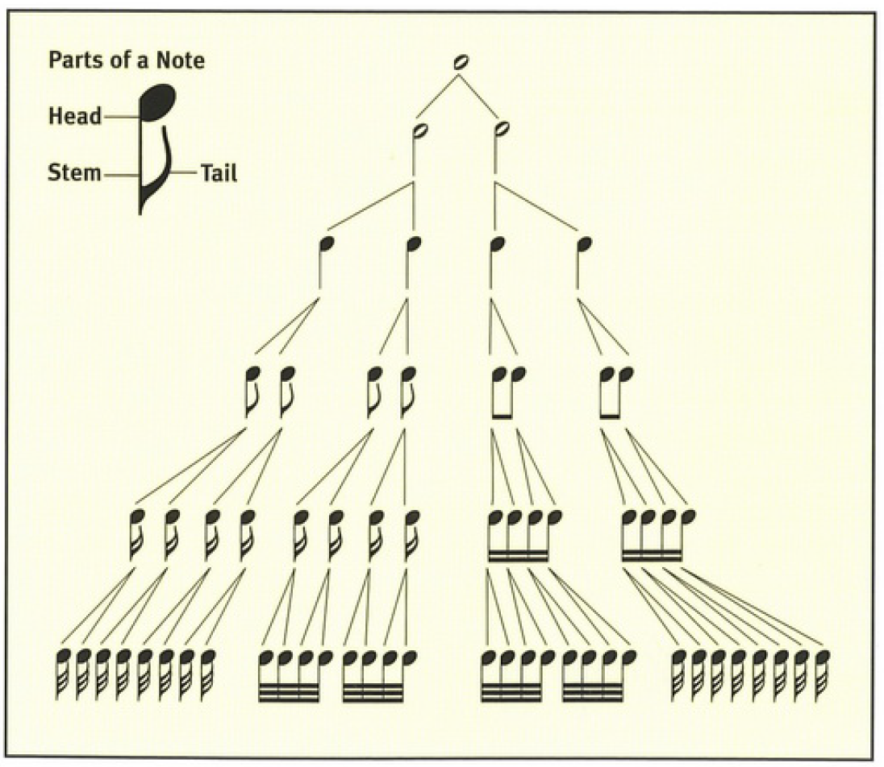
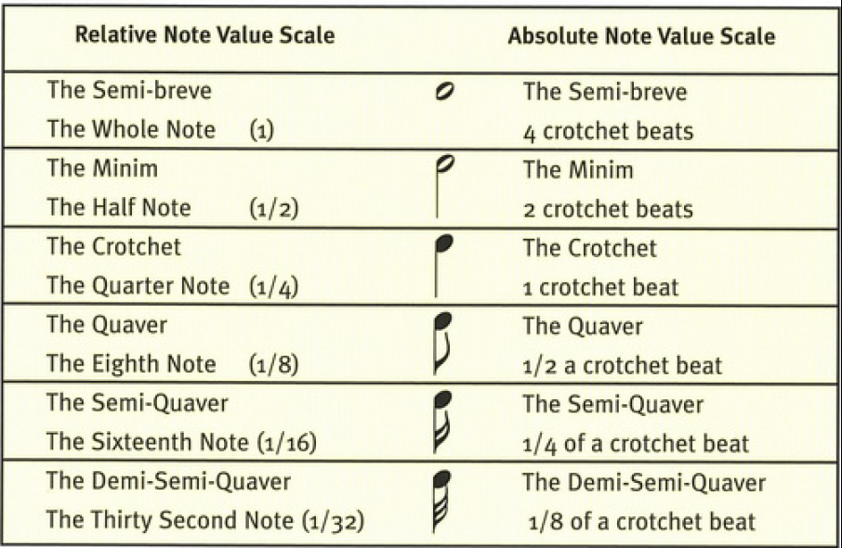
To summarise

Slide 18
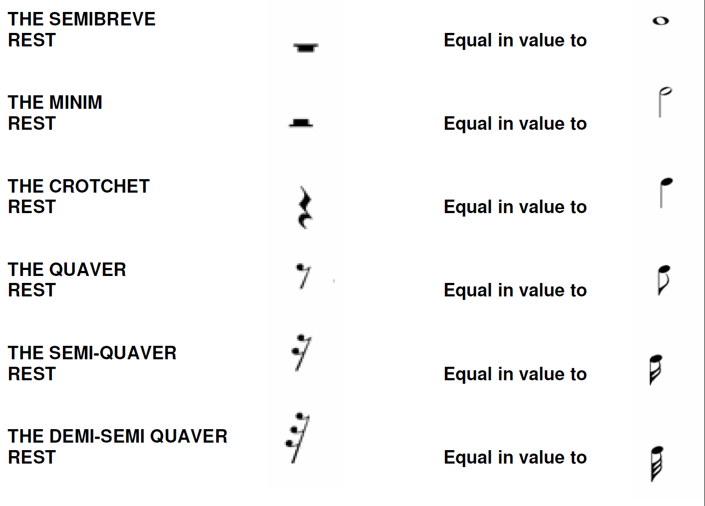
Have a rest?
As we have just learnt, there are 6 shaped we use to represent the duration of a note.
Another 6 shapes, called rests, are used to show periods of no sound.
Each note has it’s equivalent rest and shares same name.

Slide 19
More of a rest?
Rests are common in drumming, as it is a staccato instrument. Bagpipes are legato, forming a continuous sound, and so do not often have rests.
Tips to remember the rests:
  Semibreve – our biggest note, very heavy, sinks under the line
  Minim – half as big, lighter, floats above the line
  Crotchet – a straight yet squiggly line
  Quaver – a line with 1 tail at the top (a quaver note also has 1 tail!)
  Semi-Quaver – a line with 2 tails
  Demi-Semi-Quaver – a line with 3 tails

Slide 20
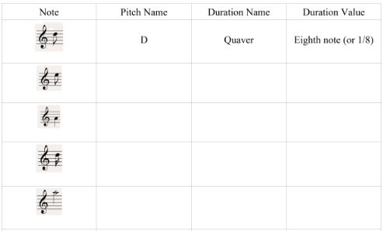
STOP AND THINK
Explain the musical term ‘duration’.
Name the note referred to as a Quarter Note. How many semi-quavers does it contain?
Which note represents two crotchets?
Complete the table below:
5. What do rests show or represent?
1. the length of a musical sound, or in other words the period of time during which a musical sound is sustained or held, 2. Crotchet = 4 semi-quavers, 3. Minim, 4. (a) e, quaver, eighth note (b) a, crotchet, quarter note (c) d, semi-quaver, sixteenth note (d) high a, minim, half note. 5. The duration of a period of silence

Slide 21

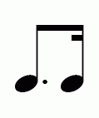

Making notes longer or shorter?
How many tails does the second note have?
Dot – adds half
Cut – takes half
What happens when we add or remove a tail?
  A tail halves the value
  Add a tail to a crotchet and you get a quaver – half the value
Vary rarely we use a double dot. This adds the value of a single dot, plus an extra half a dot.

Slide 22
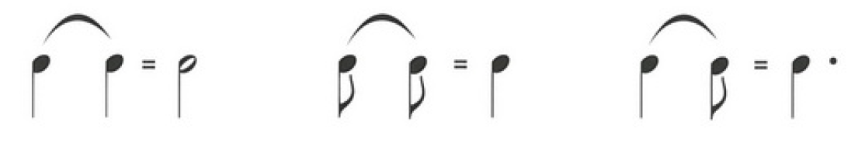
Making notes longer or shorter?
Another way to make a note longer is to combine 2 notes of the same pitch with a tie.
If we have 2 quavers of the same pitch, why don’t we join them together to form a crotchet?
  Often, this is what we would do!
  However, we only group them together when they are in the same beat. If they are across 2 different beats then we keep them with their beats and let them tie together
If we were to write the note twice without a tie then this would indicate we need to play the note twice. As the bagpipes have a continuous sound we can’t play the same note twice in a row.

Slide 23
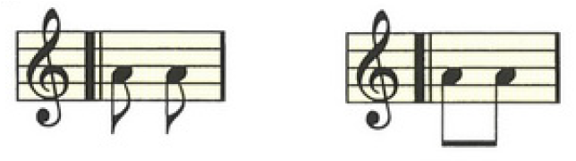
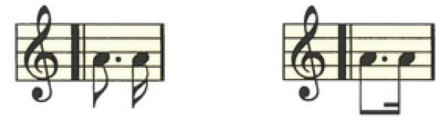
Grouping notes together
Where possible we join notes together into their beats using a beam.
The below illustration show two separate quavers (with two tails) which are then joined together with a beam using those two tails.
We call this a note grouping. A note grouping MUST add up to 1 beat.
The beat always falls at the start of a note grouping.

Slide 24
Raising the bar
When music is written, it is divided into sections which contain the same number of beats.
One of these sections is called a ‘bar’.
Bar lines are vertical lines which appear at intervals along the stave and divide the music into the required number of beats.

Slide 25
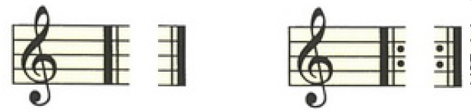
Are we playing that part again?
Pay attention to the start and end of the repeat sign. Sometimes our starting notes are not included.
While a line of music is typically 4 bars, there are also typically 2 lines in a part (8 bars of music).
Sometimes we will only play a part through once, mostly we will repeat it.
To determine if we are repeating the part we use these symbols at the start and end of a part. The first (double bar lines) indicates the start and end of the part, and the second (two dots added) indicates the repeat.

Slide 26
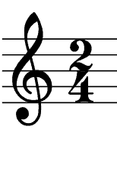
What time is it?
In order to understand the rhythm of a piece of music, it is necessary to be able to interpret its’ time signature.
The time signature appears after the clef, and is represented by two numbers, one above the other.
Top number = how many beats in a bar
Bottom number = what is the value of those beats
In pipe band music, bars normally contain 2, 3 or 4 beats.
Remember we learn about quarter notes being a crotchet
and eighth notes being a quaver?

Slide 27
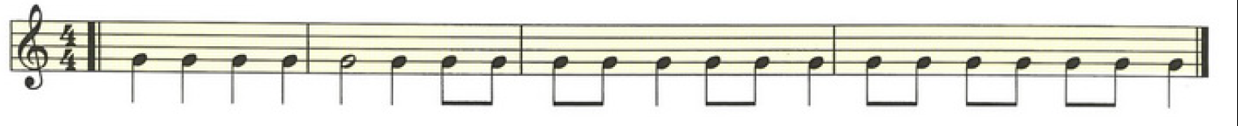
What time is it?
⁴₄ time is sometimes referred to as ‘common time’ and is written as an incomplete circle which looks like a capital C.
²₄ tells us that there are 2 notes in each bar, and that each of those notes (or note groupings) are crotchet (¼ note) beats.
³₄ tells us that there are 3 notes in each bar, and that each of those notes (or note groupings) are crotchet (¼ note) beats.
⁴₄ tells us that there are 4 notes in each bar, and that each of those notes (or note groupings) are crotchet (¼ note) beats.

Slide 28
This timing thing is simple!
Notice how with all of the groupings we can break them into 2 equal claps? Alternatively, we can think 1 … and … 2 … and
Because of how structured and constant it is, we call it simple time.
The staves on the previous slide contain examples of different note duration combinations which add up to the required number of beats in the bar, determined by the time signature.
Try tapping out the rhythm to a steady beat.
The beat will always be at the start of a note grouping.

Slide 29
STOP AND THINK
What note value would be represented by a dotted crotchet?
What is the purpose of a tie?
What does the time signature ¾ represent?
What is a bar line?
What is the purpose of a double bar line?
What does a double dot do?
1. 1 + ½ crotchets, or 3 quavers, 2. To join the notes together when two notes of the same pitch are across multiple beats or bars, where there is no embellishment to stop the constant sound 3. There are 3 quarter notes per bar 4. Vertical lines that divide the music into the correct number of beats 5. Signify the start and end of a part of music 6. Adds a single dot, plus an extra half dot

Slide 30
But what about when it’s not simple?
The other type of time we use is called compound time. This is where each beat can be broken up into 3 equal parts.
So, for each beat we will count ‘1 … 2 … 3… - 1 … 2 … 3”
Just the same as simple time, the top number gives us the number of beats in the bar, and the value of the beats.

Slide 31

But what about when it’s not simple?
For example, a ⁶₈ has 6 notes in a bar, and those are worth quavers (1/8th note).
However, given that we are breaking each beat into 3 equal parts with compound time, we can group each of these quavers into two full beat groupings – to make a dotted crotchets (1½ crotchets = 3 quavers)

Slide 32


More compound time
Where a note or rest can be divided into two notes of equal value, we call this a simple note. Where a note or rest can be divided into three notes of equal value we call this a compound note.
The compound time signatures most often used are ⁶₈, ⁹₈, and ¹²₈. Typically, these tunes will be marches or jigs.
⁹₈ tells us that there are 9 notes in each bar, and that each of those notes (or note groupings) are quaver (1/8 note) beats. Alternatively, there can be 3 dotted crotchets in each bar.
¹²₈ tells us that there are 12 notes in each bar, and that each of those notes (or note groupings) are quaver (1/8 note) beats. Alternatively, there can be 4 dotted crotchets in each bar.

Slide 33
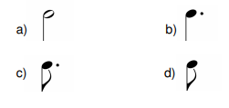
STOP AND THINK
What is a simple note?
What is a compound note?
Are the following notes simple or compound? →
What does the time signature 12/8 represent?
1. A note divisible by two, 2. A note divisible by three, 3. Simple, Compound, Compound, Simple 4. There are 12 eighth notes in each bar.

Slide 34
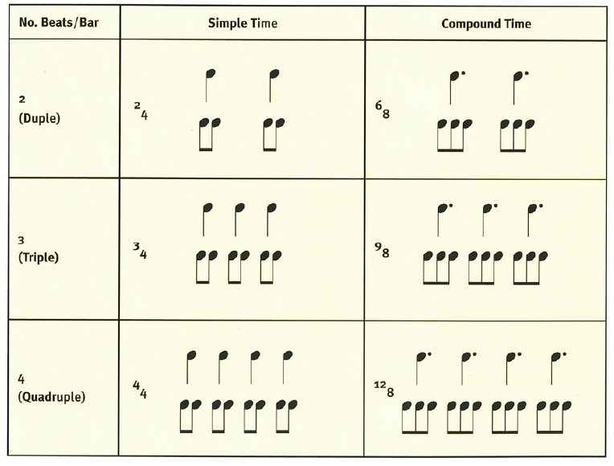
Simple vs Compound Time
Rhythm is the regular recurrence of the strong and weak accents arising from the division of the music into regular metrical portions
These rhythmical patterns generally fall into three groups, collectively known as the “kinds of time”:
    The 2 pulse pattern is call Duple Time
    The 3 pulse pattern is called Triple Time
    The 4 pulse pattern is called Quadruple Time
The relationship between simple and
compound time can be seen in this
table.

Slide 35
Simple vs Compound Time
Sing some tunes in various time signatures and think where the emphasis is. Now that you know what the expression is supposed to be, are you singing it differently?
Each of these kinds of time have different pulse patterns:
  Duple time has a pattern of Strong – Weak
  Triple time has a pattern of Strong – Weak – Weak
  Quadruple time has a pattern of Strong – Weak – Medium - Weak
Questions to think about:
1. How many kinds of time are there?
2. If a pulse pattern was STRONG-WEAK-MEDIUM-WEAK, what kind of time
would it be?
3. Give the pulse pattern for simple duple time.
1. 3 – duple, triple, quadruple 2. Quadruple time, 3. Strong, Weak

Slide 36
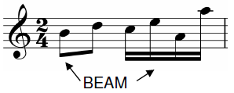
The rules of writing music
The head of the note must be clearly written either on a line or space. If a note is in a space it should just touch both the top and bottom lines. All note heads should be the same size.
Stems always go downwards with tails either going up to the right of the stem or joined together as part of a note grouping. These tails should be easily distinguishable.
Where possible, all notes should be grouped into a beat note by beams to show that they are obviously part of that beat note.

Slide 37

The rules of writing music
All tails or beams must be written below the lowest line of the staff (first line).
Embellishments must clearly indicate what is being played by their relative position. For piping this will indicate which note is being played and for drummers this will indicate which hand is being used.

Slide 38

The rules of writing music
Notes and embellishments should be evenly spaced to ensure it is as easy as possible for the reader to understand the music.
Where dots and cuts are used, the direction of the cut should be directed at the relevant dot.
The above principles apply equally when using rests

Slide 39
THE NEXT SECTION IS REQUIRED FOR THE ELEMENTARY CERTIFICATE

Slide 40
The mechanics of sound
Memorise me!
There are four elements required to produce sound:
Originator - Piper / Drummer
(2) Vibrating Body - Reeds / Drumskins
(3) Medium - Air / Water
(4) Receptor - Ear
Should any one of these elements be missing, then sound cannot be produced.

Slide 41
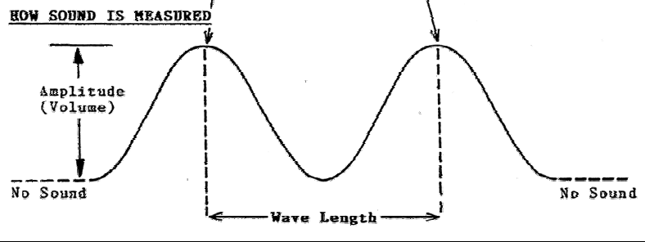
How do sound waves work?
The key components are amplitude (how high/loud) and wave length (pitch).
The higher the amplitude the louder the sound will be
The shorter the wave length the higher the pitch will be
We measure sound in Hertz (Hz) being how many cycles of a wave length are there per second
Bagpipers will often mention a number like
480 to tune to. That’s 480 vibration cycles per second!

Slide 42
STOP AND THINK
What would happen if we tried to play bagpipes or drums in a vacuum (no air or water?)
What else could be a receptor?
What would happen to the sound wave if we had a very loud and sharp noise?
What happens as the pitch increases?
Answers: 1. No sound would be transmitted, 2. A microphone, the body of an animal (i.e. shark), 3. Big amplitude, short wave length, 4. We eventually end up at a new note.

Slide 43
Types of musical sound
There are TWO kinds of musical sound:
Legato - Smooth and connected
Staccato - Short and detached
The Characteristics of Sound
(1) Pitch – the height or depth of sound
(2) Volume – Loudness of softness, the intensity of the sound
(3) Quality – Timbre, tone quality

Slide 44
Types of musical sound
Timbre is the quality of musical sound. This quality is affected by other sounds produced at the same time as the main pitch note.
  The main pitch is call the fundamental, and the other sounds known as harmonies, overtones or partials
  The harmonics of two different instruments can make them sound nice when played together
When two instruments sound alike, this is due to the similarity of the harmonics

Slide 45
STOP AND THINK
Do bagpipes produce Legato or Staccato sound?
Do drums produce Legato or Staccato sound?
If you were comparing the sound produced by 2 bagpipes and one sounded nicer than the other, how could you describe the difference in sound quality?
What are the characteristics of musical sound?
What are the two kinds of musical sound?
1. Legato, 2. Staccato (Note: A roll on the snare drum consists of a rapid succession of sounds, which, when played correctly, will give the impression of a Legato sound), 3. Good timbre. 4. Pitch, volume, quality 5. Legato and staccato

Slide 46


Tempo, Volume and Expression
Tempo is the speed at which a piece of music is played
We can use some words to describe the tempo broadly:
  Allegro = fast
  Lento = slow
Volume is the loudness or softness of the music being played
  Bagpipers use embellishments to provide the effect of changes to volume
  Drummers can vary their volume using dynamics, or expression
  To change a number of notes we use the symbols crescendo (gradually louder) and diminuendo (gradually softer)
  To change individual notes we use symbols called accents
The first and second time respectively of a part are called the Piano (P) and Double Forte (FF).

Slide 47
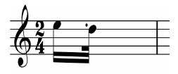


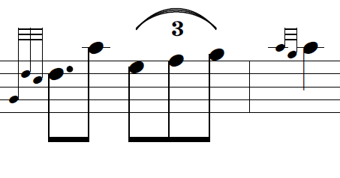
What else should I know?
Anacrusis
We sometimes use incomplete bars to introduce the music, called an anacrusis
If the part is repeated, or there is an anacrusis at the start of the next part, the last bar in the part will also an an incomplete bar which, when added to the anacrusis, will have value equal to a complete bar.
Repeats
Sometimes when we repeat parts we don’t play the same thing both times We can use these symbols to indicate which time we play the bars (1st or 2nd)
Irregular Groupings
Occasionally we want to divide a beat note into a greater or lesser number of parts than normal. This is common is strathspey music to play a run of 3 quavers over 1 beat. We represent this with a tie and 3

Slide 48
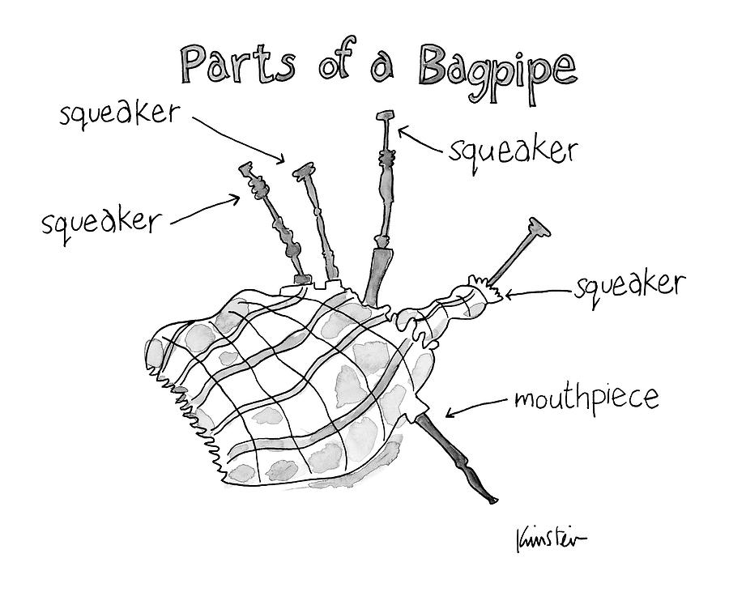
How do bagpipes make sound?
Reeds in the chanter and drones send air vibrating up the drones and out of the chanter
The length for the vibrations to get out impacts pitch. The longer the column of air, the lower the pitch (i.e. bass drone vs tenor drone, high a vs low g)
When we tune the chanter and drones we are trying to match up the vibrations from all of the vibrating bodies (drone reeds, chanter reeds) to the same Hz.

Slide 49
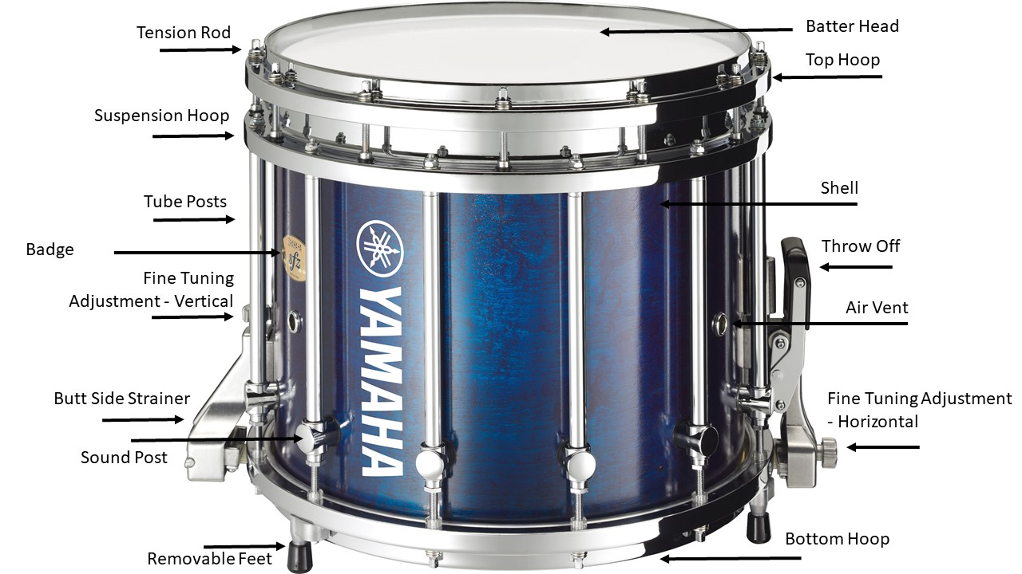
How do drums make sound?
The size of the drum (room for vibrations to move) also impacts sound
Think of a small tenor drum vs a bit bass drum
The heads (top and bottom) are stretched tight to cause shorter wave lengths and a higher pitch
The snare drum produces sounds with complex overtones and a wide range of frequencies such that no single, definite pitch is discernible – called indefinite pitch
This is why we write drum scores on a single line
But hang on! A snare drum doings higher in pitch than a bass drum? This is called relative pitch

Slide 50
STOP AND THINK
What happens when all of the bagpipes or drums are in tune together?
What can influence the sound created from a bagpipe or drum?
What happens to the sound when a drummer uses an “accent”?
Answers: 1. The amplitude (volume) increases, 2. Tuning, the pressure/blowing from the player, moisture, dampening to the drum, sticks, how hard the drum head is hit, mould, etc. 3. The amplitude/volume increases.

Slide 51
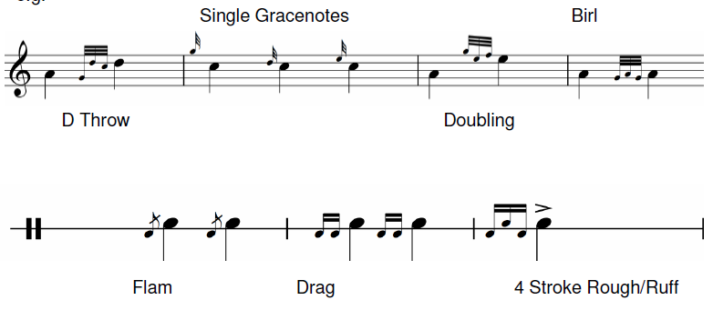
Embellishments
While drummers can vary their volume to create dynamics, the only way bagpipers can is to use embellishments to emphasise certain notes or rhythms.
Both bagpipers and drummers have embellishments
With both piping and drumming, embellishments are not considered to have value when putting the notes into bars for timing purposes. Instead, they form part of the value of the note that follows the embellishment.

Slide 52
What else do I need to study?
Get familiar with the RSPBA Structured Learning – Book 1
Practice the technique exercises in Book 1
Know how to tune and maintain your instrument (chanter for prelim, bagpipes for elementary), and the names of the various parts
Practice your music writing
Practice the monotone (clapping) exercises in Book 1 – elementary level
Be confident at sight reading - elementary level
Find practice exam papers at the Piping and Drumming Qualification Board (PDQB)
Exam enrolment form - https://www.pipebandsaustralia.com.au/college

